Slide 1
The Software Testing Life Cycle
Why We Test

Slide 2
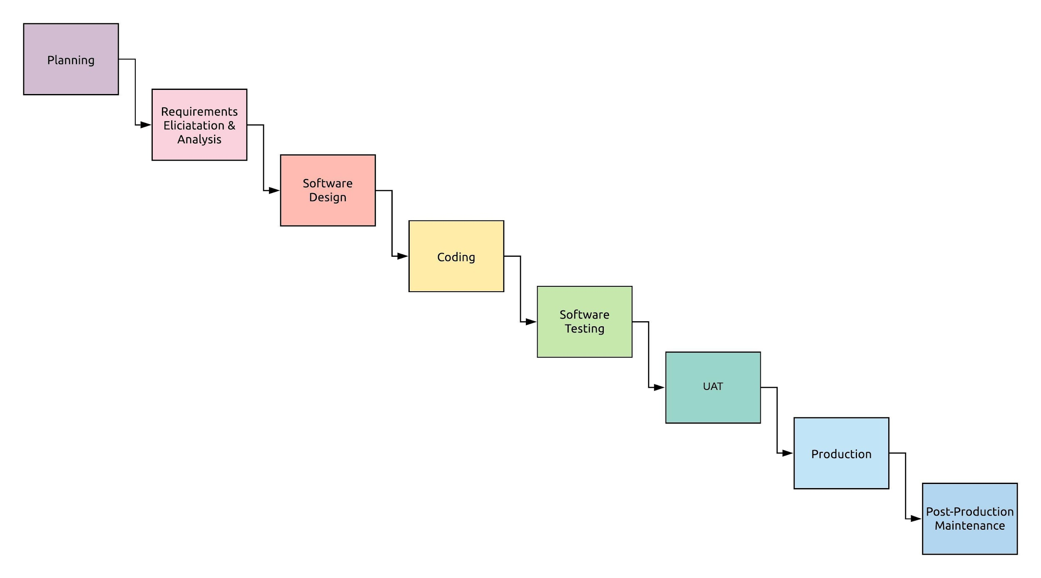
SDLC

Slide 3

Software Testing Is...

Slide 4
Software Testing Is NOT...
Optional
An afterthought
A chore
Time-consuming
Strictly about code coverage!

Slide 5
The Scenario (Who Needs Tests Anyway?)
Given you’re developing an application
When you send your application to a production environment
Then you…
Want to ensure that the software meets the stakeholders’ expectations and helps achieve business objectives.
Want to secure your users’ information.
Want to quickly and easily make changes to your application if needed.
Want to assure quality.

Slide 6
What is Software Quality?
Well, what is quality? Quality can describe an application’s conformance with:
Functional aspects and
Structural aspects
Both focused on finally meeting stakeholders’ expectations.

Slide 7
Quality Assurance
Quality Assurance means the maintenance of a desired level of quality in a service or product, especially by means of attention to every stage of the process of delivery or production.
Ensuring that the correct process is followed to develop the software.
Focuses on avoiding defects from getting introduced in the software.

Slide 8
Quality Control
A system of maintaining standards in manufactured products by testing a sample of the output against the specification.
Checking if the product (software) that has been developed works as per requirements specifications.
Focuses on finding defects in the software.
STLC (Software Testing Life Cycle) is the part of Quality Control process.

Slide 9
So Quality Assurance...
Emphasizes the usage of standard software development processes and practices guaranteeing quality.
Increases chances of developing the final product that is bug-free and meets stakeholders’ requirements.

Slide 10
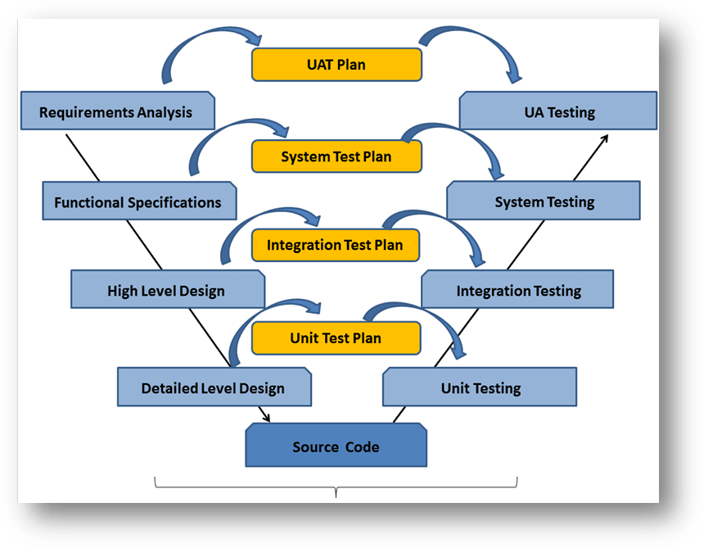
The Software Testing Life Cycle (STLC)

Slide 11
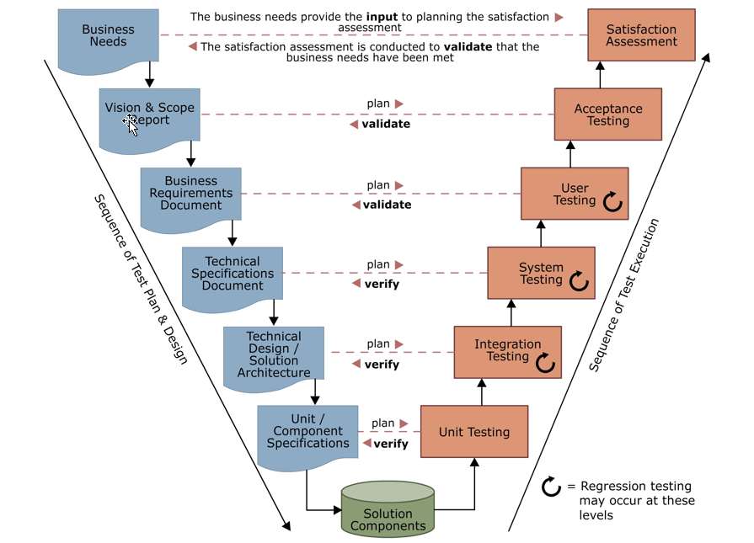
The Software Testing Life Cycle (STLC)

Slide 12
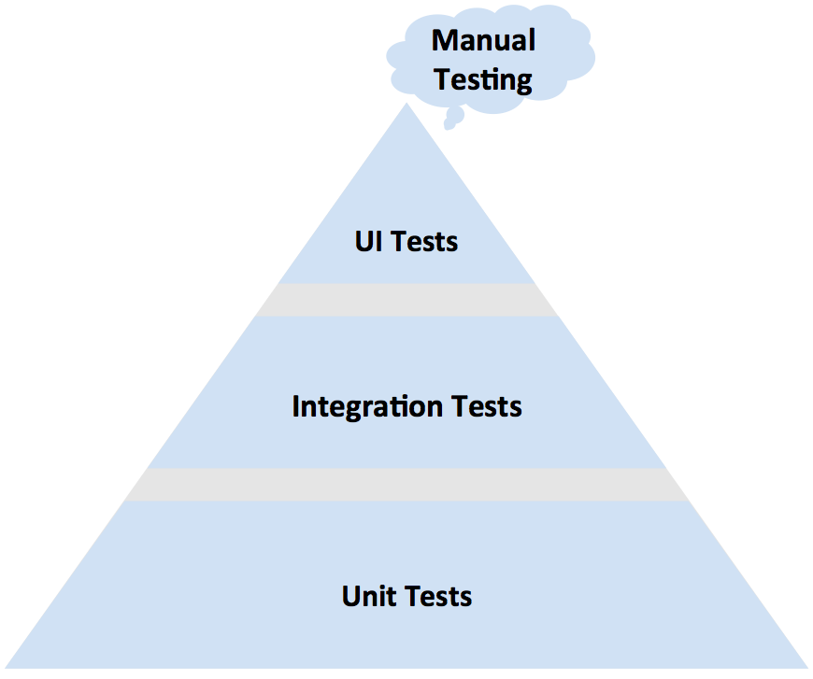
The Testing Pyramid

Slide 13
Unit Testing
Entails testing software at the most micro level
Imagine testing a single unit of your application…
or just a tiny “piece” of a requirement.
Usually requires that we “mock” out dependencies...
manually or via a mocking framework.
Should make up the greater part of your testing.
Is considered fast and cheap!

Slide 14
Integration Testing
Entails testing all units with their dependencies.
Ensures that all units and their dependencies function properly together.
Should account for a large portion of your testing.

Slide 15
System Testing
Entails testing the application as “a whole”.
Verifies that the flow of the application is correct.

Slide 16
User Acceptance Testing
Entails testing an application - but typically from the perspective of an end user.
This includes alpha testing and beta testing.
Validates that we’ve actually built the application that the customer needs.
Key challenge is to differentiate between Defect & Change Request.

Slide 17
Functional Testing
The goal:
To test that the application performs all of the tasks that is should perform at a bare minimum.
A task that software “should” perform is determined by the requirements.
Example of Functional Requirement:
A user should be able to upload up to 5 expense reimbursement receipts per request. Allowed formats: .doc, .docx, .pdf, .jpeg. Each document should be less than 5 MBs

Slide 18
Non-functional Testing
The goal:
To test the application’s additional metrics. These might include:
Performance
Security
NOTE: An application can be functional and fail all non-functional tests.
Example of a Non-Functional Requirement:
Each expense reimbursement receipt should be uploaded within 10 seconds.

Slide 19
Positive & Negative Testing
Positive Testing: Positive Testing means verifying if the software works as per requirements specifications - both from an expected behavior as well as error handling point of view.
Negative Testing: Negative Testing means trying to break the software by creating situations that try extreme inputs or exploit fringe combinations and verifying if the software handles the situation gracefully or not.
Example: Imagine that in a software, a User’s Profile is expected to support uploading of up to 5 images in the JPEG format with each image less than or equal to 5MBs. The software is also expected to throw errors if more than 5 images or images in other format or images bigger than 5 MBs are uploaded.
Positive testing means checking each of these rules and verifying that software works accordingly.
Example: Uploading 100 images at the same time.
Example: Uploading video files instead of images.
Example: Uploading an image that is 100 MBs.
In all these cases, the software should not freeze/crash and instead give the expected error messages.

Slide 20
Smoke Testing & Sanity Testing
Smoke Testing means testing the important features of the software to see if they work as per the specifications.
Smoke testing is typically used when initial builds of the software are developed for the first time.
Once stable, smoke tests can be automated.
Sanity Testing means testing newly developed features or defects fixed in a new build created during later revisions of the software.
Sanity Testing also focuses on regression testing.
The regression tests part sanity testing can be automated.

Slide 21
Test Driven Development (TDD)
Emphasizes creating and writing test cases before we begin developing the application.
“But there’s no code! I don’t know what to test!”
Developers Everywhere
“The perfect time to test your application is before you’ve written it.”
Some Developer

Slide 22
The Benefits of TDD
The Obvious Benefit: All of your tests are already written!
Less Apparent Benefits:
It provides more direction during the development process.
It saves time during the development process.

Slide 23
But What Should I Test?
The Bad Answer: “Everything.”
Testing for testing’s sake isn’t strategic.
Code coverage isn’t everything.
The Better Answer: “The Requirements”

Slide 24
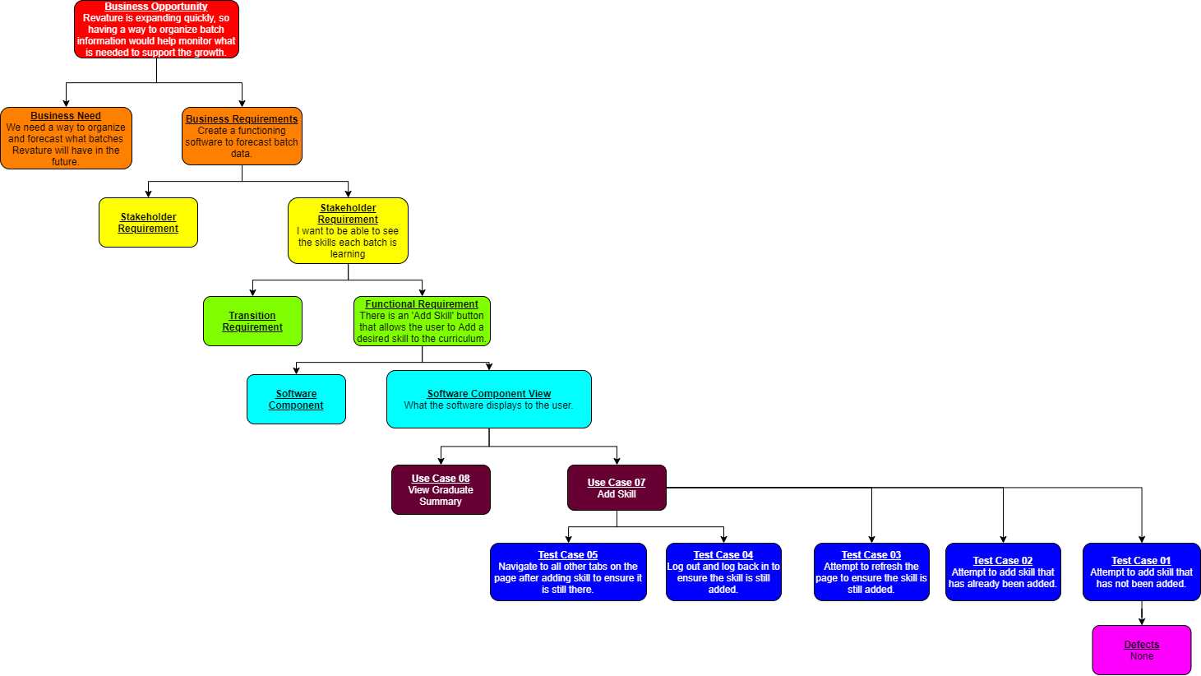
Requirements Traceability Matrix

Slide 25
Defect Reporting
Test Case was written and executed.
Actual Result was not equal to Expected Result.
Test Case Failed.
Defect found and reported (logged into Defect Management tool).
No. 1 reason for defect rejection: Defect not reproducible.

Slide 26
Defect Reporting
Defect ID
Feature / Use Case ID
Test Case ID
Defect Description
Urgency of the defect
Impact of the defect
Timestamp
Tester who found the defect
Screenshot of actual result.
Test Data that was used for testing.

Slide 27
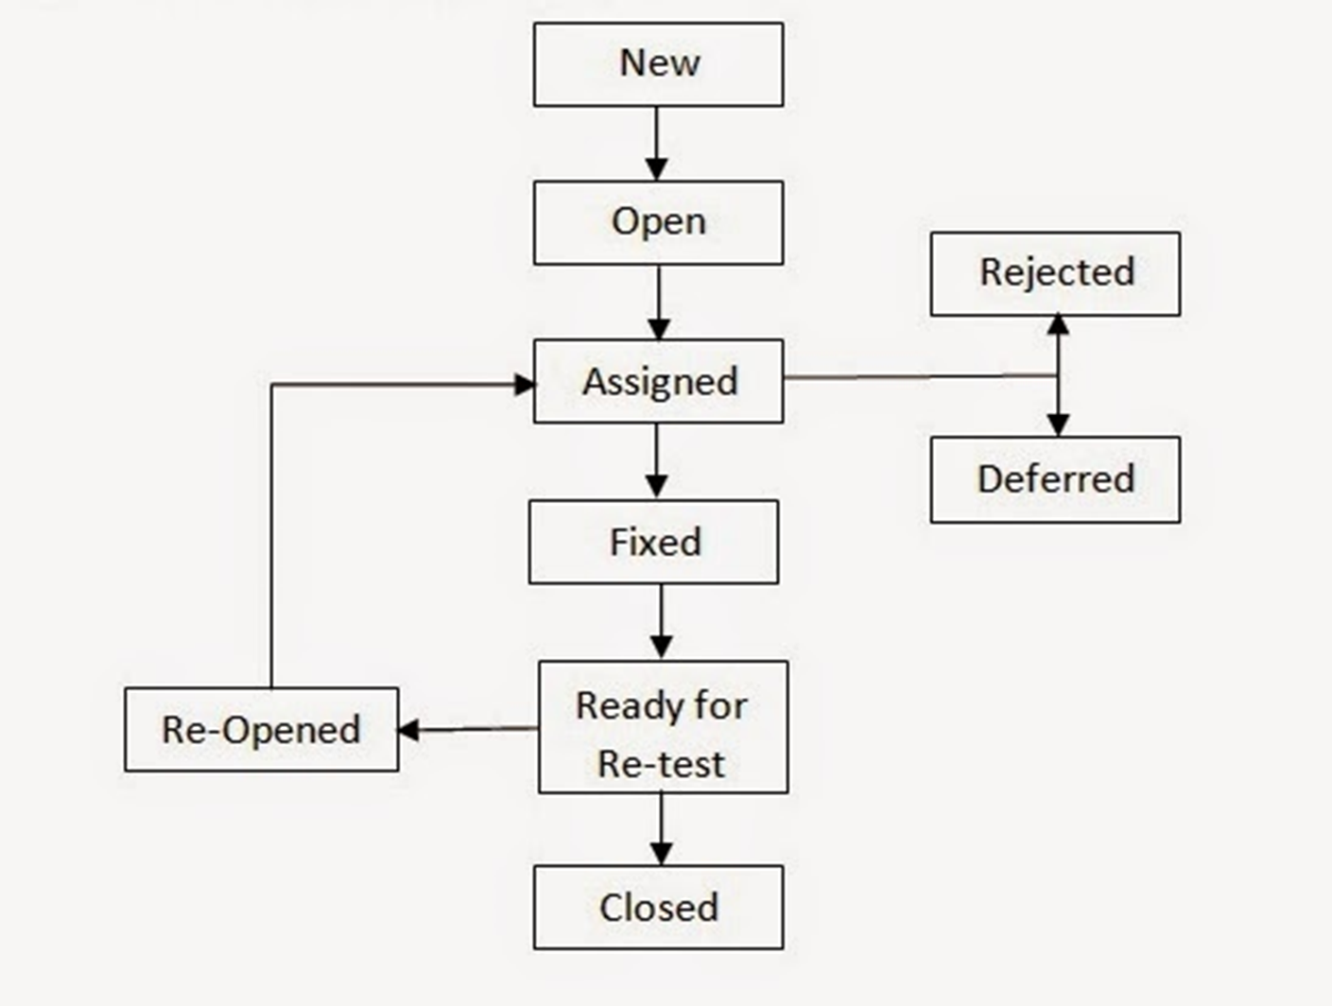
Defect Life Cycle

Slide 28
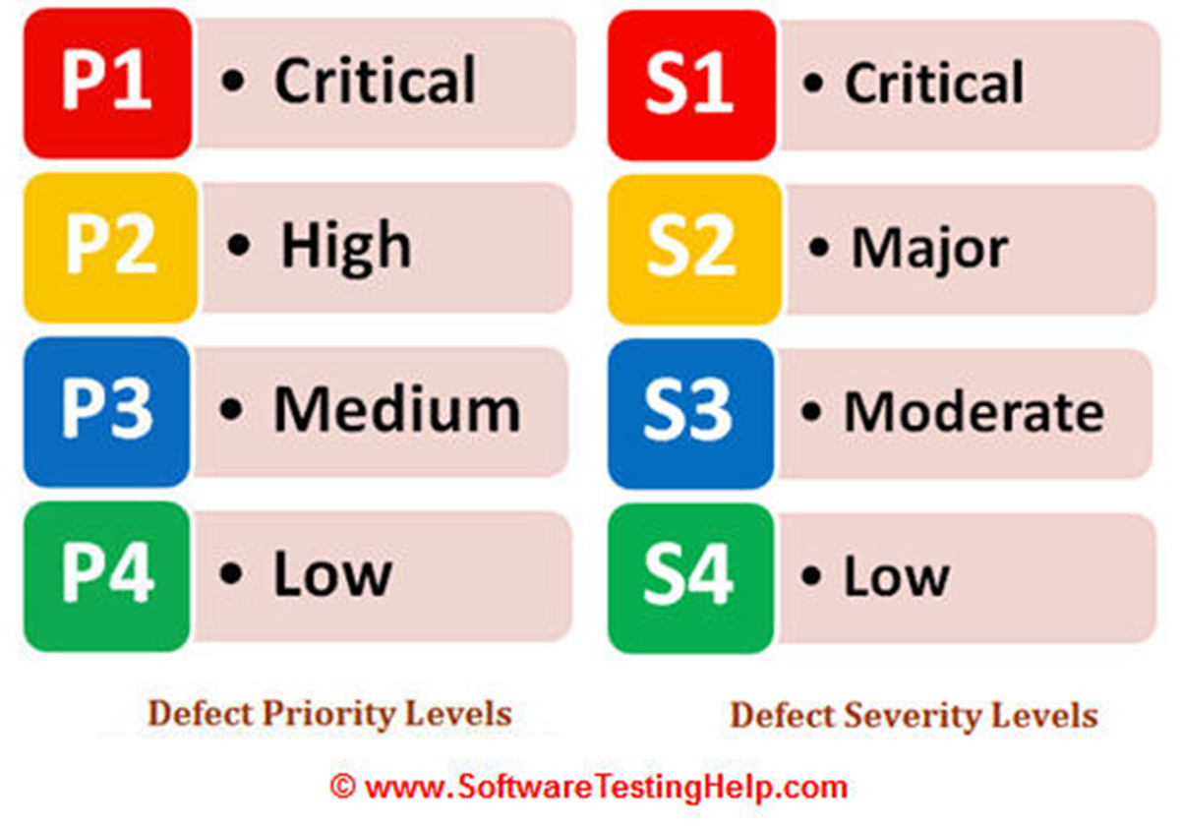
Defect Priority & Severity
Defect Severity
the severity of a defect would indicate the effect it has on the system in terms of its impact.
Defect Priority
The priority of a defect would indicate the urgency with which it would need to be fixed.

Slide 29
Defect Priority & Severity
A defect is classified as S1 (Critical) when the issue has impact on wide range of users and the application is almost unusable e.g. Large number of users are unable to login to Facebook.
A P1S1 defect means that the system has been rendered unusable and the issues must be resolved immediately.
Severity & Priority is used to rationalize decision making since any team will always have only limited resources.

